Slide 1
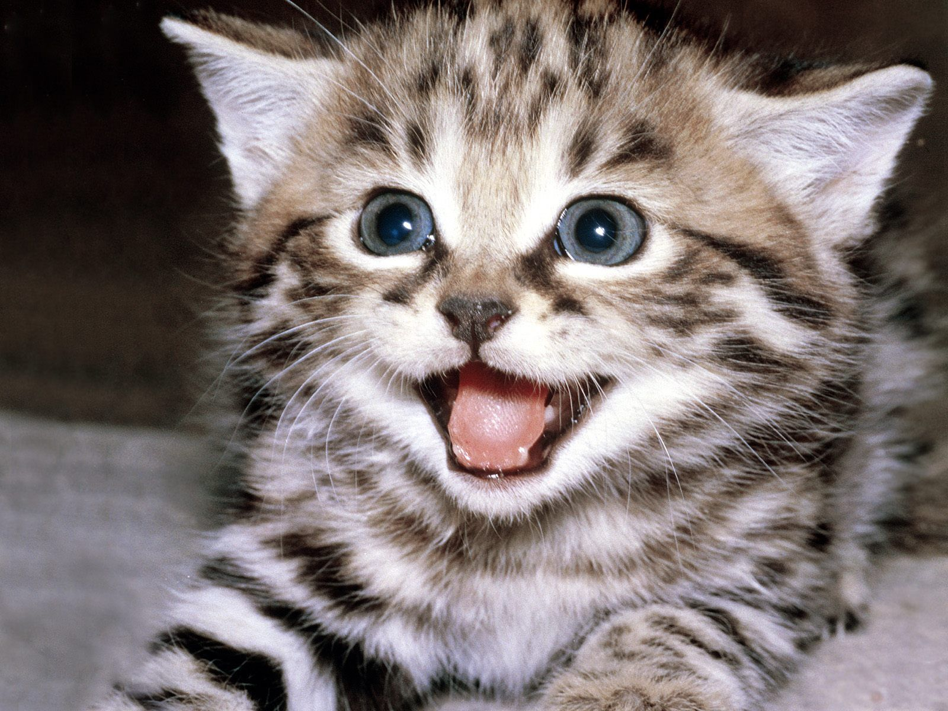
Week Four
Lit Terms

Slide 2
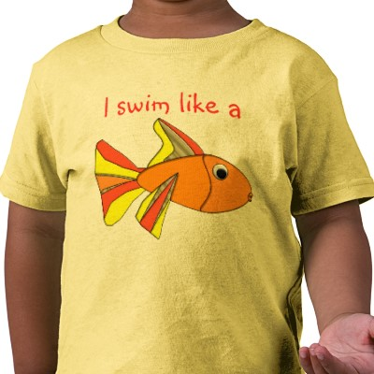
Simile
LIKE a metaphor, compares two unlike things.
Uses the words like and as.
Examples:
Brrr! It’s as cold as a polar bear’s nose.
He swims like a fish.

Slide 3
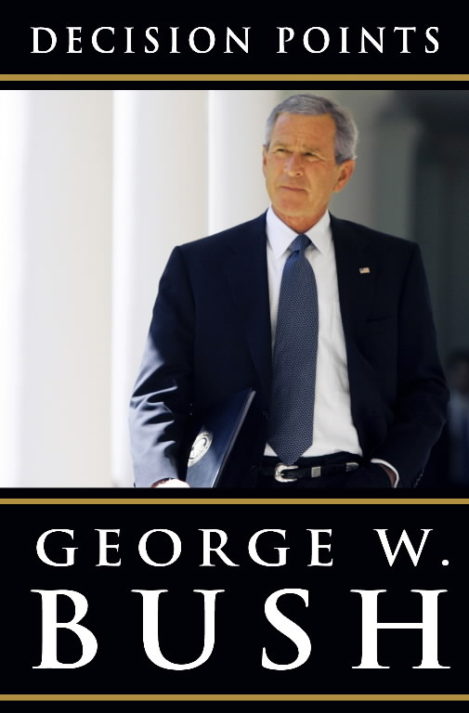
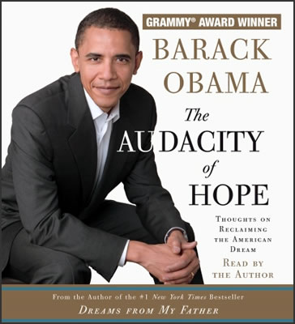
Subject
The person whose life story is told in a biography or autobiography.
Examples:
The subject of Decision Points is former President Bush.
The subject of The Audacity of Hope is current President Obama

Slide 4
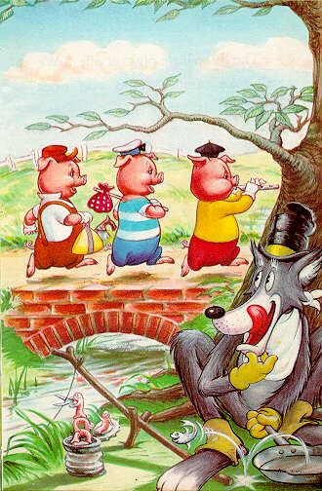
Theme
The message, or “main idea,” of the writing.
The theme of a piece of fiction is its view about life and how people behave.
Examples:
- In The Three Little Pigs, the theme could be how to build a good house or how to protect yourself from predators.
- In The Outsiders, the theme could be friendship or never-ending violence between social classes.

Slide 5
Tone
The writer’s attitude towards the subject or theme.
Use adjective to describe tone.
Tone may be formal, informal, intimate, solemn, somber, playful, serious, ironic, condescending, etc.
Critical
Serious
Playful!

Slide 6
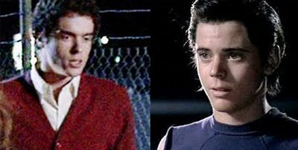
Tone
Example from The Outsiders:
Randy: You can't win. You know that, don't you? It doesn't matter if you whip us, you'll still be where you were before, at the bottom. And we'll still be the lucky ones at the top with all the breaks. It doesn't matter. Greasers will still be Greasers and Socs will still be Socs.
The tone is serious, desperate, bitter…

Slide 7
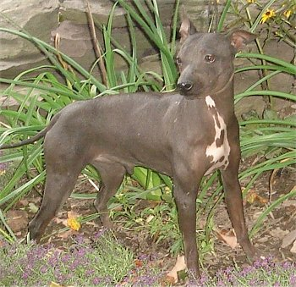
Topic Sentence
A sentence that states the main idea of a paragraph.
Commonly the first sentence of a paragraph.
Example:
- Dogs do not always have fur. According to Dog Daily Magazine, there are many breeds of dog that do not have fur. For example, the American Hairless Terrier is a common small dog with no fur…

Slide 8
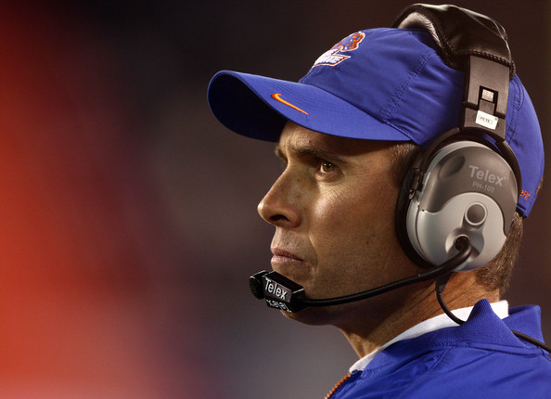
Understatement
A type of irony.
Something is made to seem less than it really is.
For example, less important, less special, less serious.
Example:
The neighborhood is flooded:
“Hm. Seems we’re having a little rain here in Kuna.
The Broncos have an outstanding record in football:
Coach Pete: “Yeah, we’ve won a few games.”

Slide 9
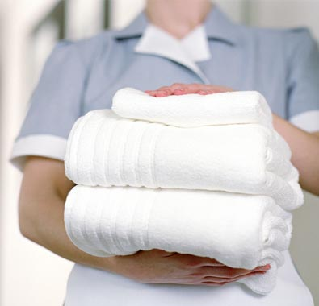

Verbal Irony
A type of irony
The character says one thing, but means something different.
Think sarcasm
Examples
Mom is holding her son’s clean laundry:
“Your humble servant has arrived with your laundry.”
“Oh, great. Thanks. I just love it when you come in my room without knocking.”

